Slide 1
Machine learning and its application in bio-photonics
Roopam K. Gupta

Slide 2
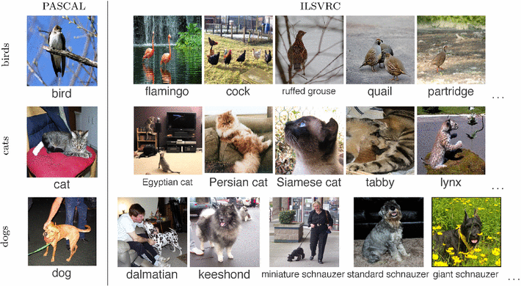
How is machine learning helpful?
Near human performance of Convolutional neural networks for classification
O. Russakovsky et. Al. “Imagenet large scale visual recognition challenge” Int. J. Comput. Vis. 115,211-252 (2015).

Slide 3
Google translate overlaying English translation for a pack of milk
Google tap to translate
Notes:
Identification of text
Detection of language
Translation of language
Regeneration of translated text image!

Slide 4
Self driving cars
Self driving cars!
Reference: https://www.youtube.com/watch?v=0rc4RqYLtEU&t=61s

Slide 5
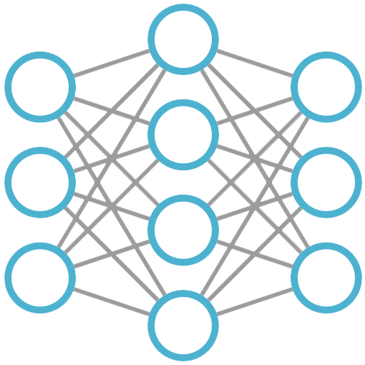
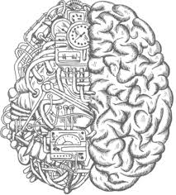
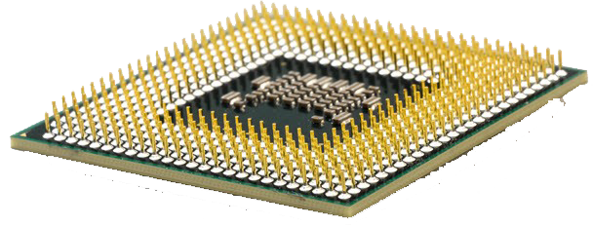
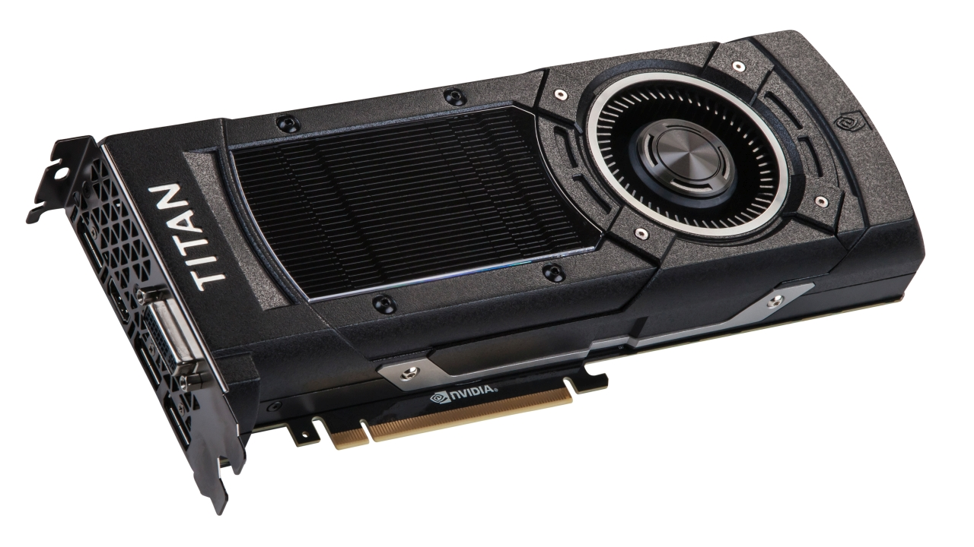
Artificial Intelligence timeline
ML
Deep learning
Artificial Intelligence
Idea conceived in 1950s
Machines could classify
without human intervention
Machines performed tasks
with near human precision
1950s
1980s
2010s

Slide 6
Machine learning to Deep learning
Machine Learning
Car
Not Car
Input
Feature Extraction
Classification
Output
Deep Learning
Car
Not Car
Input
Feature extraction and Classification
Output

Slide 7
What’s a neural network and how does it work?
$$σ(w_{1i}∗x_{i}+b_{i})$$
$$\frac{e^{z_{j}}}{\sum_{k=1}^{K}{e^{z_{k}}}}$$
$$w_{1i}∗x_{i}$$
1
Iterate
Input($x_{i}$)
P.D.
Output($z_{i}$)
Notes:
Transformation via parameterization
Adding nonlinearity to each transformation
Probabilistic classification

Slide 8
Simply put

Slide 9
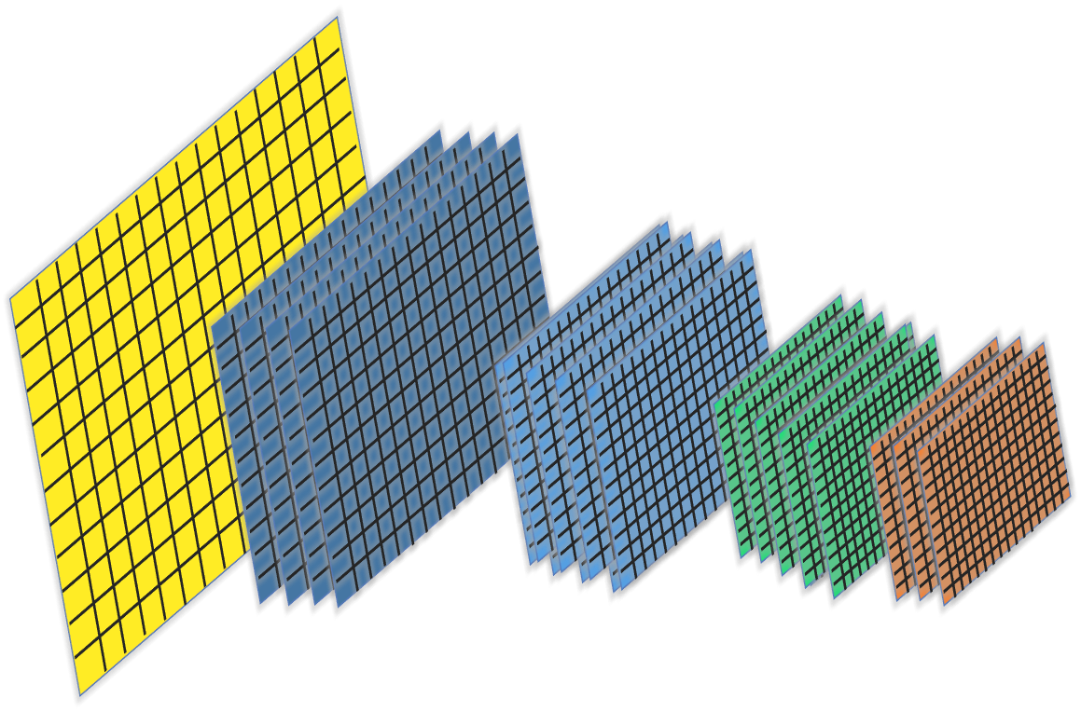
Convolutional neural networks for classification of N-dimensional data
Dense connections
Class 1
Sparse Connections
Class 2
Higher dimensional data
Convolution Blocks

Slide 10
What does a convolution block contains?
Convolutional layer
Pooling Layer
1
1
1
0
1
1
1
0
x1
X0
1
1
1
0
2
1
1
1
1
0
1
1
X0
X1
0
0
1
1
0
1
0
0
1
1
0
1
0
0
1
0
Convolved features
0
0
1
0
Pooled features
Parameterized Filter
Max Pooling Filter
Non linearity Layer
1
1
1
0
1
1
1
0
1
-1
1
0
1
0
1
0
0
0
1
1
0
0
1
1
0
-5
1
0
0
0
1
0

Slide 11
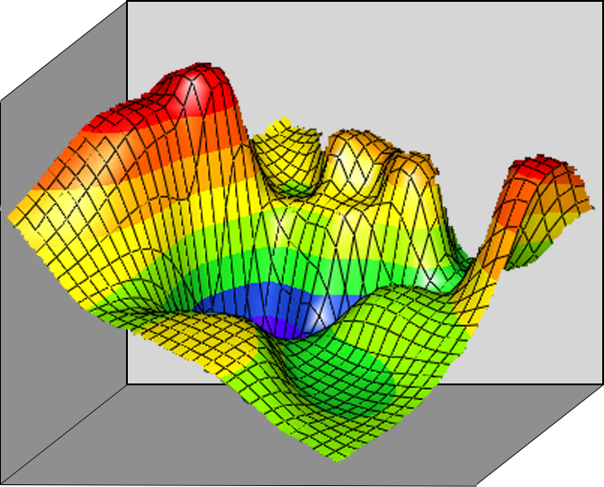
Training a neural network
Input
Output
$$\frac{dC}{dW_{end}}$$
$$\frac{dC}{dW_{end−1}}$$
$$\frac{dC}{dW_{end−2}}$$
Inspired by the animal learning methods
Network Trained
Max Cost
Train the network by minimizing:
$$Cost= \left\{\begin{aligned}−\log\left(output\right) if target=1 \\ −\log\left(1−output\right) if target=0\end{aligned}\right.$$
Backpropagate the error $\frac{dC}{dW_{i}}$ to update the parameters
using stochastic gradient descent
C
Min Cost
$$w_{j}$$
$$w_{i}$$

