Slide 1
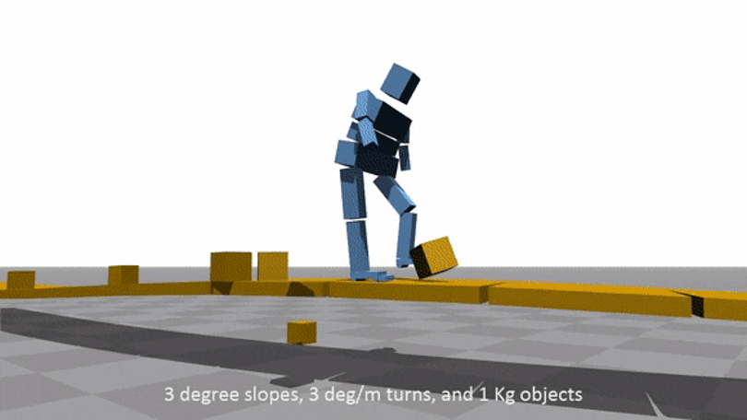
Things every computational physicist should be aware of…
Lewis McMillan
lm959@st-andrews.ac.uk
github.com/lewisfish
T. Geijtenbeek et al. (2013)
Notes:
Intro
Overview reseach

Slide 2
Introduction
I’m not an expert on any of these topics
Not an exhaustive list by any means
Talk Contents
Binary
Floating-Point numbers
Random Numbers
Various Algorithms
This Photo by Unknown Author is licensed under CC BY

Slide 3
Binary
Representation of numbers in base 2
Used in almost every computer due to “on/off”
Represent the number 30 in base 2
100 10 1
0 3 0 = 10 + 10 +10 = 30
32 16 8 4 2 1
0 1 1 1 1 0 = 2 + 4 + 8 + 16 = 30

Slide 4
Binary
Represent the number 30 in base 2
100 10 1
0 3 0 = 10 + 10 +10 = 30
32 16 8 4 2 1
0 1 1 1 1 0 = 2 + 4 + 8 + 16 = 30
011110b = 30
1 bit is either 0 or 1
1 byte is 8 bits

Slide 5
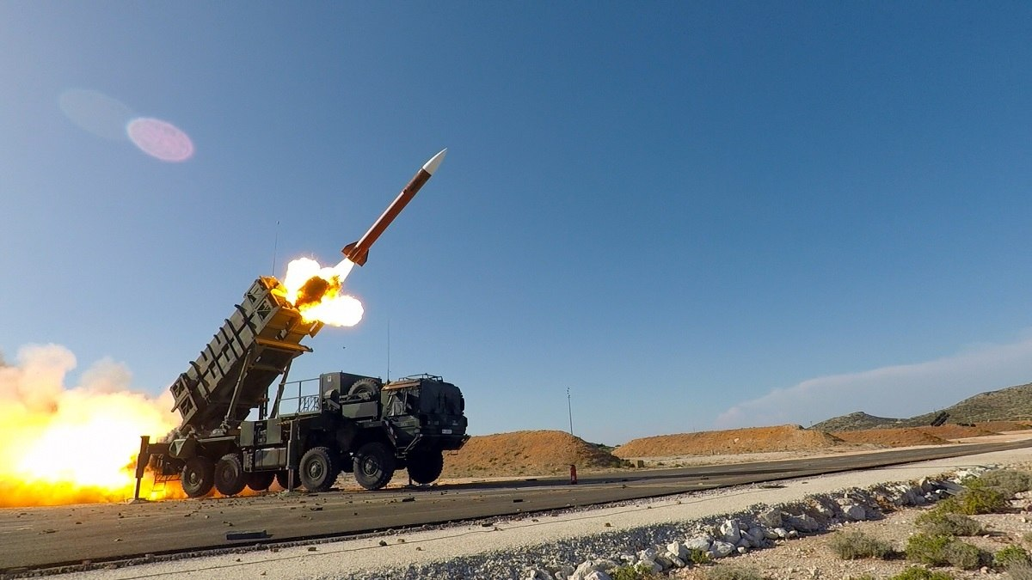
Floating-point numbers
Floating-point numbers should we be worried?
Maybe…
Really depends on what you are doing
0.1 + 0.2 = 0.3000000000000004
www.gao.gov/assets/220/215614.pdf
(Photo by Anthony Sweeney/U.S. Army Europe)
Notes:
1st Iraq war 1991
Conversion of time from in to 24bit float
Running 100hrs
.333s out => 600m
28 soldiers died
1 day later software updated…

Slide 6
Floating-point numbers
What are they?
$${(−1)}^{S}∗1.M∗2^{(E−127)}$$
S = sign
M = mantissa
E = exponent
32 bits used to represent numbers in IEEE 754 standard
F. Sanglard (2017)
Notes:
Exponent == window
Mantissa == offset

Slide 7
Floating-point numbers
S = sign
M = mantissa
E = exponent
Represent e=2.72 in floating-point
$${(−1)}^{S}∗1.M∗2^{(E−127)}$$
S = 0
E = 128
M = $\frac{2.72−2}{4−2}=$0.36
F. Sanglard (2017)
Notes:
S=0 as +ive
E = 128 as 2.72 between 2^1 and 2^2
M = 3439329 as 2^23 offsets available in interval [2-4]. It is at (2.72-2)/(4-2)=.41 => 2^23*.41 ==3439329

Slide 8
Floating-point numbers
S = sign
M = mantissa
E = exponent
Represent e=2.72 in floating-point
S = 0 0b
E = 128 10000000b
M = $\frac{2.72−2}{4−2}=0.36∗2^{23}$ 01011100001010001111011b
$${(−1)}^{S}∗1.M∗2^{(E−127)}$$
$${(−1)}^{0}∗1.36∗2^{(128−127)}$$
0 1 0 0 0 0 0 0 0 0 1 0 1 1 1 0 0 0 0 1 0 1 0 0 0 1 1 1 1 0 1 1
Notes:
S=0 as +ive
E = 128 as 2.72 between 2^1 and 2^2
M = 3439329 as 2^23 offsets available in interval [2-4]. It is at (2.72-2)/(4-2)=.41 => 2^23*.41 ==3439329

Slide 9
Floating-point numbers
Main problem in floating-point representation
Can’t exactly represent all real numbers!
0 1 0 0 0 0 0 0 0 0 1 0 1 1 1 0 0 0 0 1 0 1 0 0 0 1 1 1 1 0 1 1
2.72 != 2.7200000286102294921875
Notes:
S=0 as +ive
E = 128 as 2.72 between 2^1 and 2^2
M = 3439329 as 2^23 offsets available in interval [2-4]. It is at (2.72-2)/(4-2)=.41 => 2^23*.41 ==3439329

Slide 10
Floating-point numbers
Muller’s recurrence
$$f\left(y,z\right)=108−\frac{815−{1500}/z}{y}$$
$$x_{i}=f(x_{i−1},x_{i−2})$$
$$x_{0}=4$$
$$x_{1}=4.25$$

Slide 11
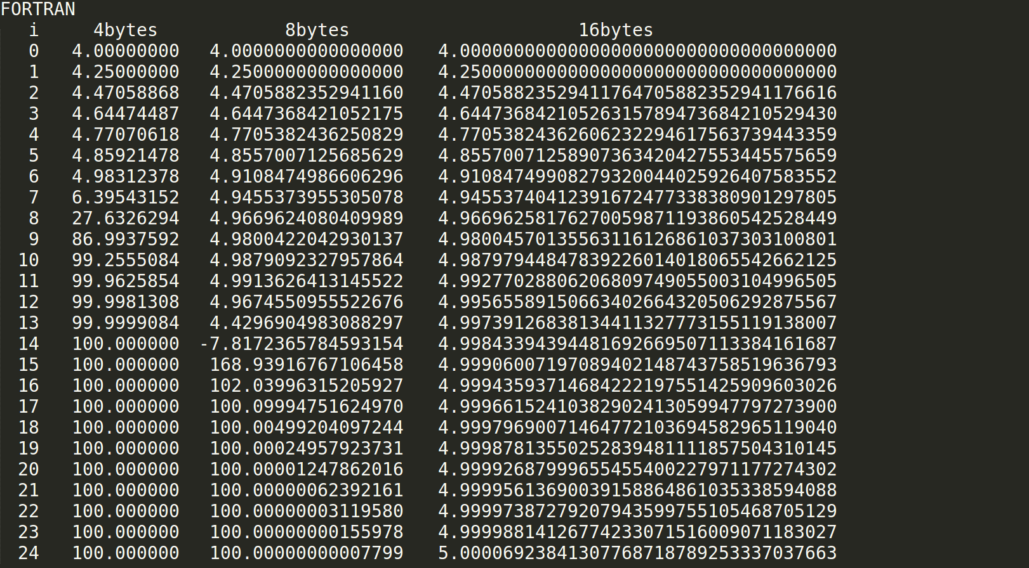
Floating-point numbers

Slide 12
Floating-point numbers
Can’t exactly represent all real numbers!
Errors can accumulate
Multiplication and division are “safe”
Addition and subtraction can be dangerous
Loss of digits can be ok or catastrophic
The more calculations are done, i.e. iterative algorithms, the more danger there usually is
Notes:
+ & - dangerous when different magnitudes involved. Can lose digits of smaller number
Ok or bad depending how it effects result

Slide 13
Floating-point numbers
If you really want to know more…
https://floating-point-gui.de
https://randomascii.wordpress.com/category/floating-point
https://doi.org/10.1145/103162.103163
Notes:
47 pages dense theory

Slide 14
Random numbers
Is the random number generator I use “random” enough??
Maybe
So long as you use a generator that passes “basic” tests should be ok
Depends on application

Slide 15
Random numbers
A good RNG is fast, has a long period and passes various tests
Linear Congruent Generator (LCG)
Choose a, c and M
Can make “good” and “bad” choices
$$y_{i+1}=mod(ay_{i}+c,M)$$
Notes:
Quick and dirty
Used a lot in 60-70’s

Slide 16
Random numbers
A good RNG is fast, has a long period and passes various tests
Ran
Numerical recipe’s own RNG
“Minimal random number generator of Park and Miller combined with a Marsaglia shift sequence”

Slide 17
Random numbers
A good RNG is fast, has a long period and passes various tests
Fortran’s internal
No defined algorithm
Gfortran: xorshift1024*

Slide 18
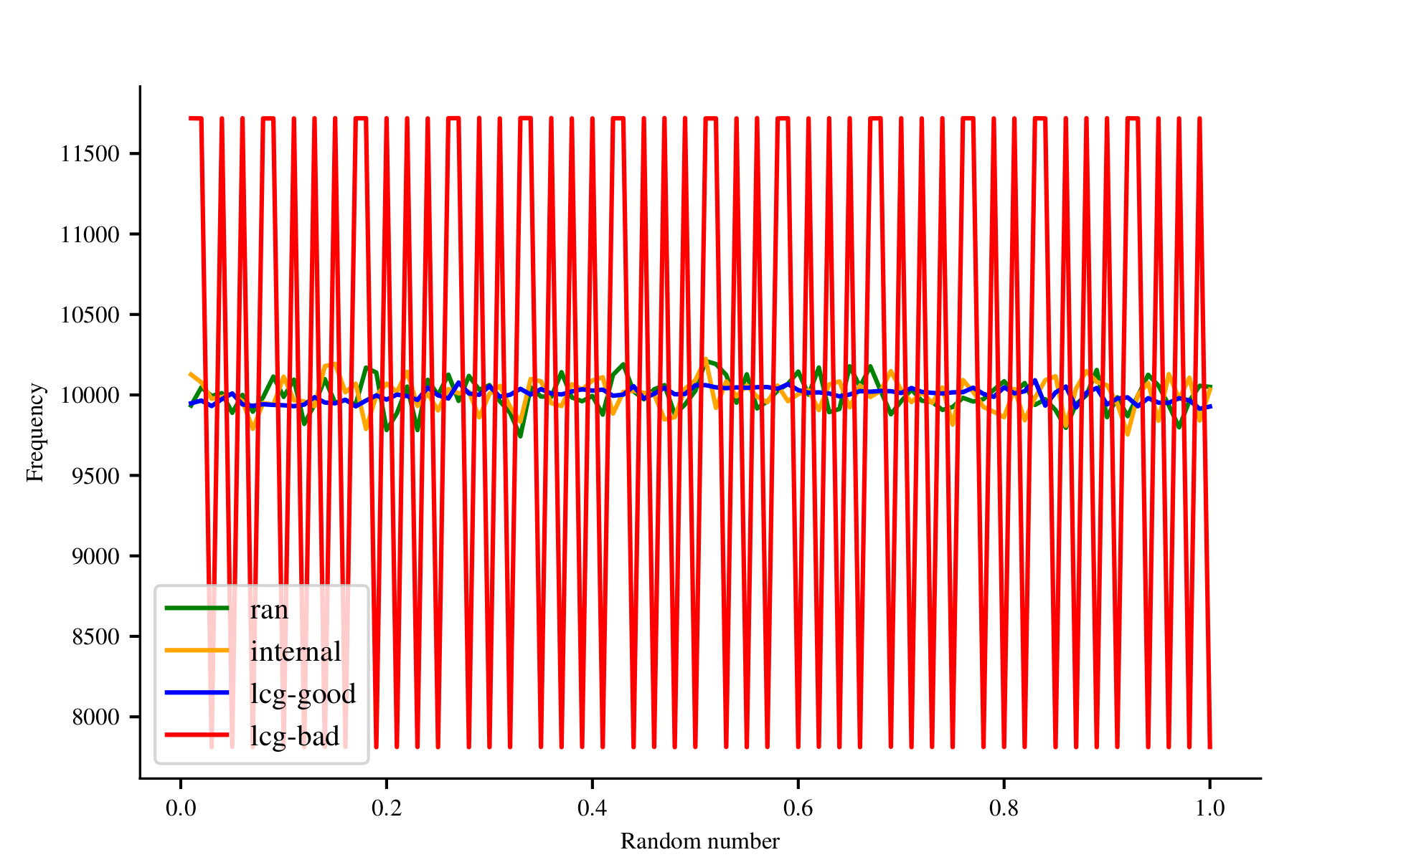
Random numbers

Slide 19
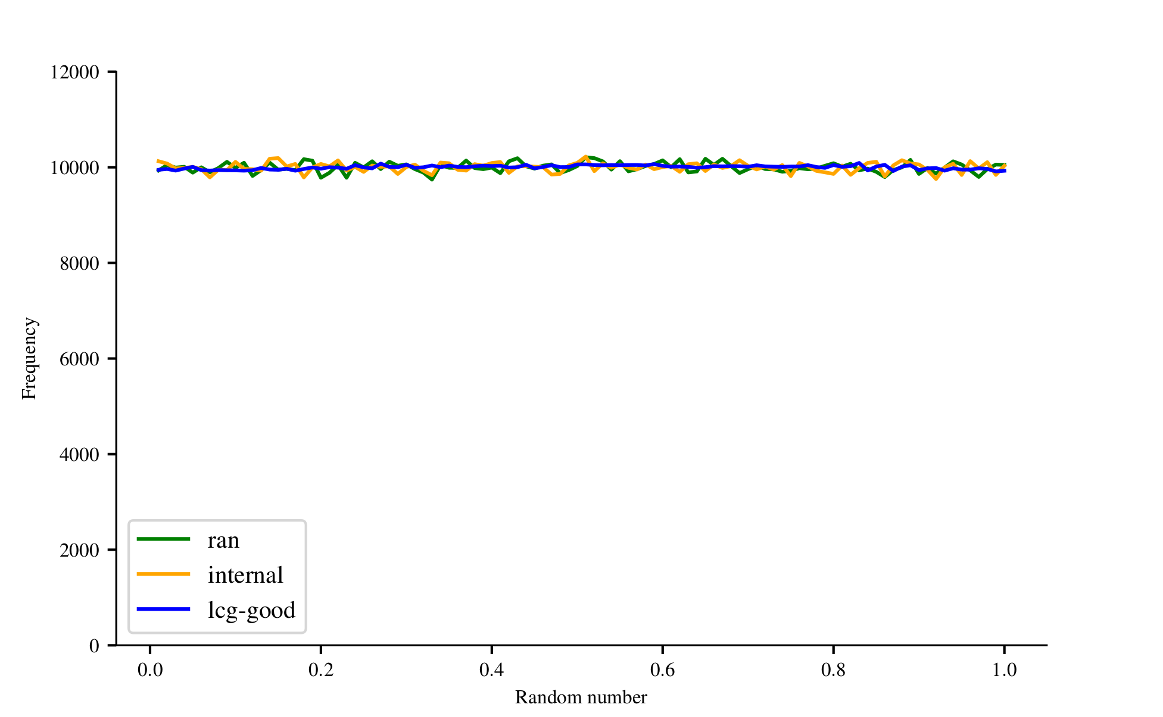
Random numbers

Slide 20
Random numbers
Simple test: test correlation of pairs of numbers
LCG
Ran2
Fortran’s internal
ε$\left(N,n\right)=\frac{1}{N}\sum_{i=1}^{N}{x_{i}x_{i+n}}−E{\left(x\right)}^{2} n∈ℕ$

Slide 21
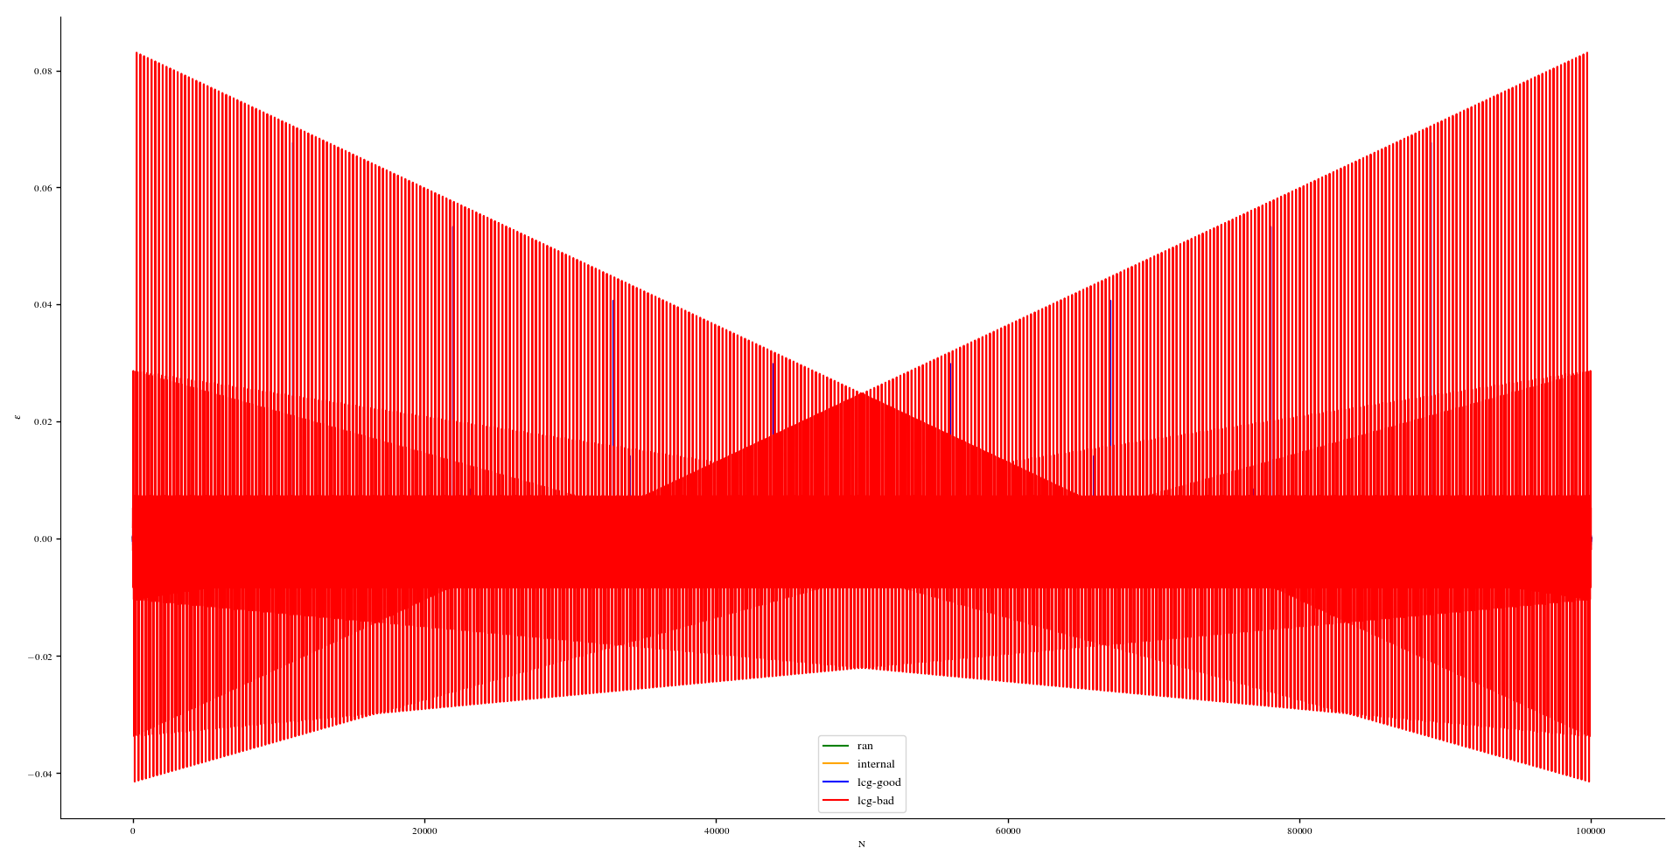
Random numbers

Slide 22
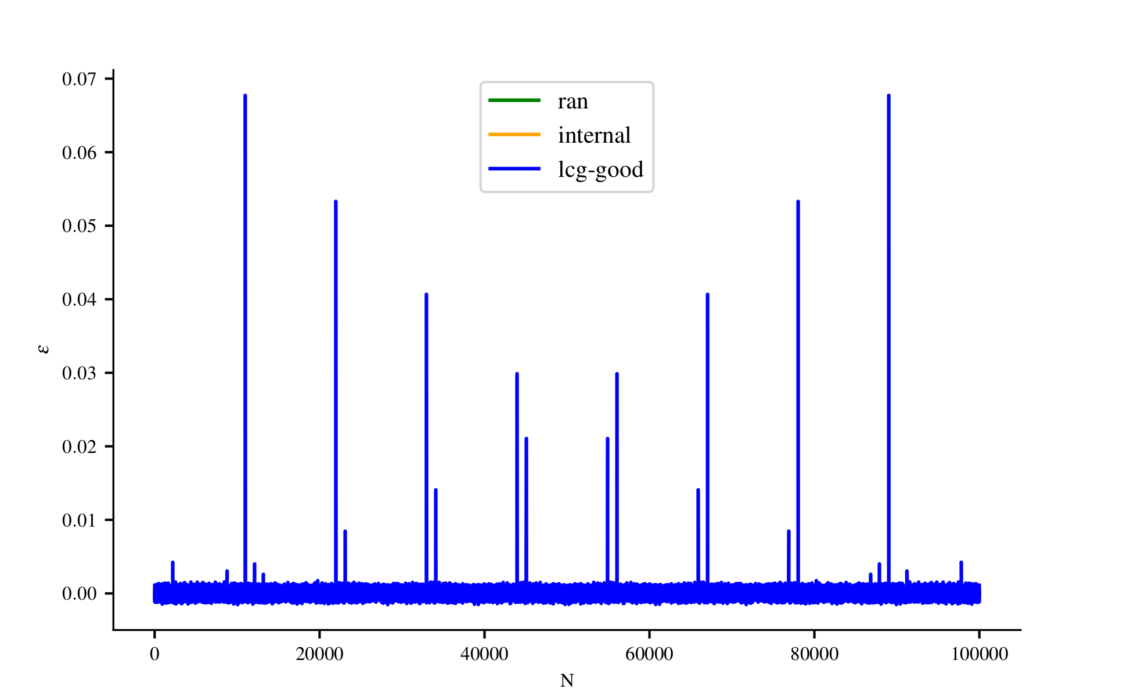
Random numbers

Slide 23
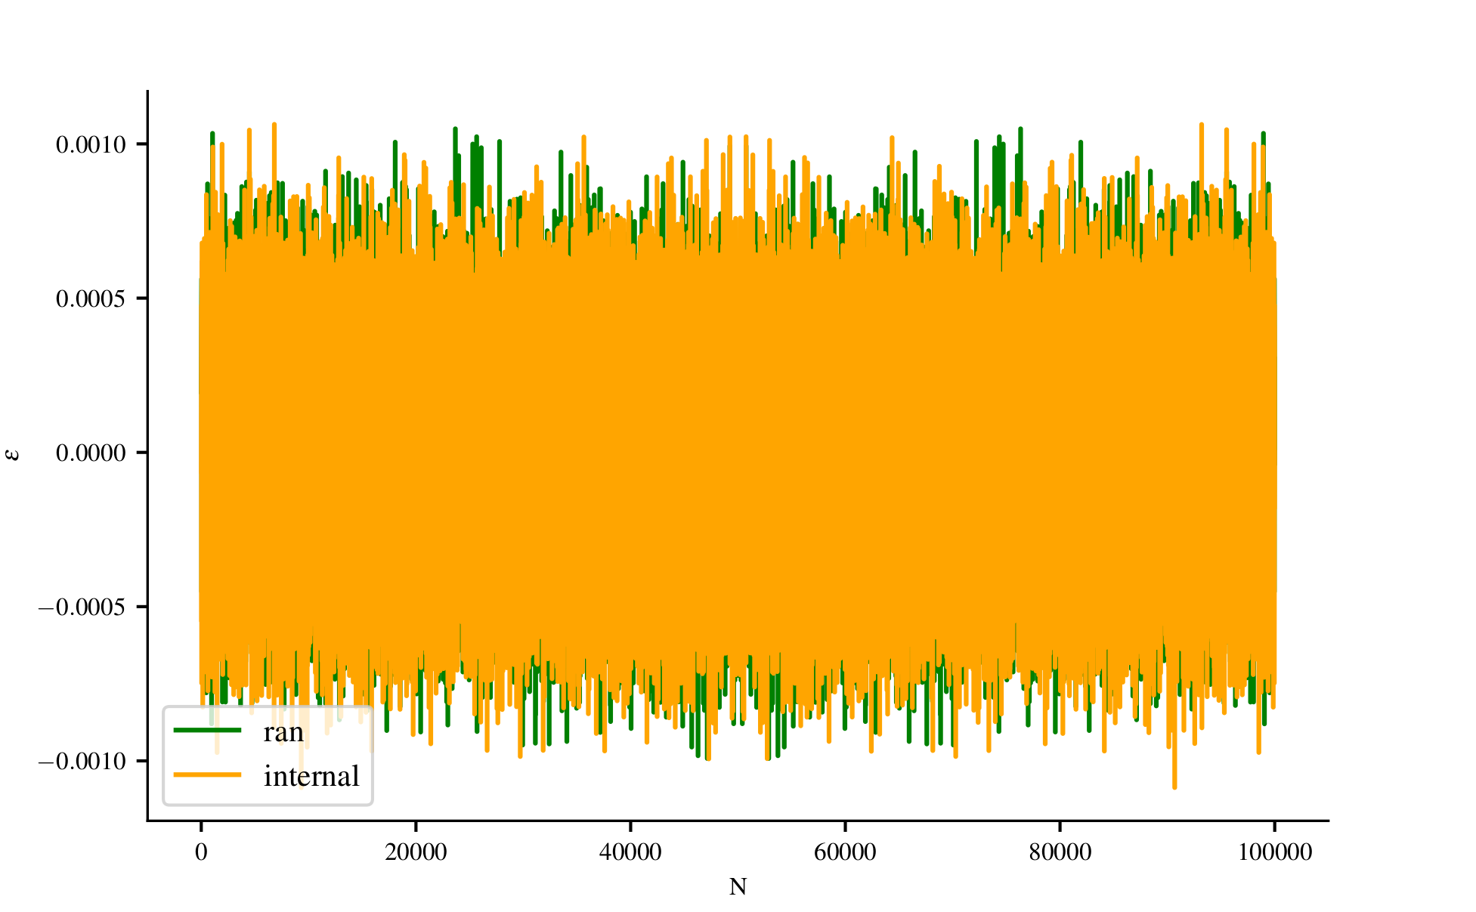
Random numbers

Slide 24
Random numbers
From ‘Numerical Recipes’
Never use a LCG
Never use a RNG with period < 2⁶⁴
Never use a RNG that warns against using low-order bits

Slide 25
Random numbers
Don’t use via http://www0.cs.ucl.ac.uk/staff/d.jones/GoodPracticeRNG.pdf
Perl’s standards RNG
Python’s random() before v2.3
Java.util.Random
C-library rand(), random() or drand48()
Matlab’s rand
Mathematica’s SWB generator
ran0() or ran1() from ‘Numerical Recipes’
Notes:
Bioinformatics prof at ucl

Slide 26
Random numbers
Recommended by H.Katzgraber www.arxiv.org/abs/1005.4117
Use WELL generators, Mersenne twister or multiplicative lagged Fibonacci generators
Don’t use UNIX inbuilt or any of ‘Numerical Recipes’ RNG
Notes:
Comp physics Prof @ Texas A&M University

Slide 27
Random numbers
Further reading:
https://link.springer.com/chapter/10.1007/978-3-642-21551-3_3
http://www0.cs.ucl.ac.uk/staff/d.jones/GoodPracticeRNG.pdf
https://arxiv.org/pdf/1005.4117.pdf
Numerical Recipes / W. Press, S. Teukolsky, W. Vetterling, and B. Flannery

Slide 28
Algorithms
Brief tour of:
Monte Carlo Method
Finite difference method
Bounding volume hierarchy

Slide 29
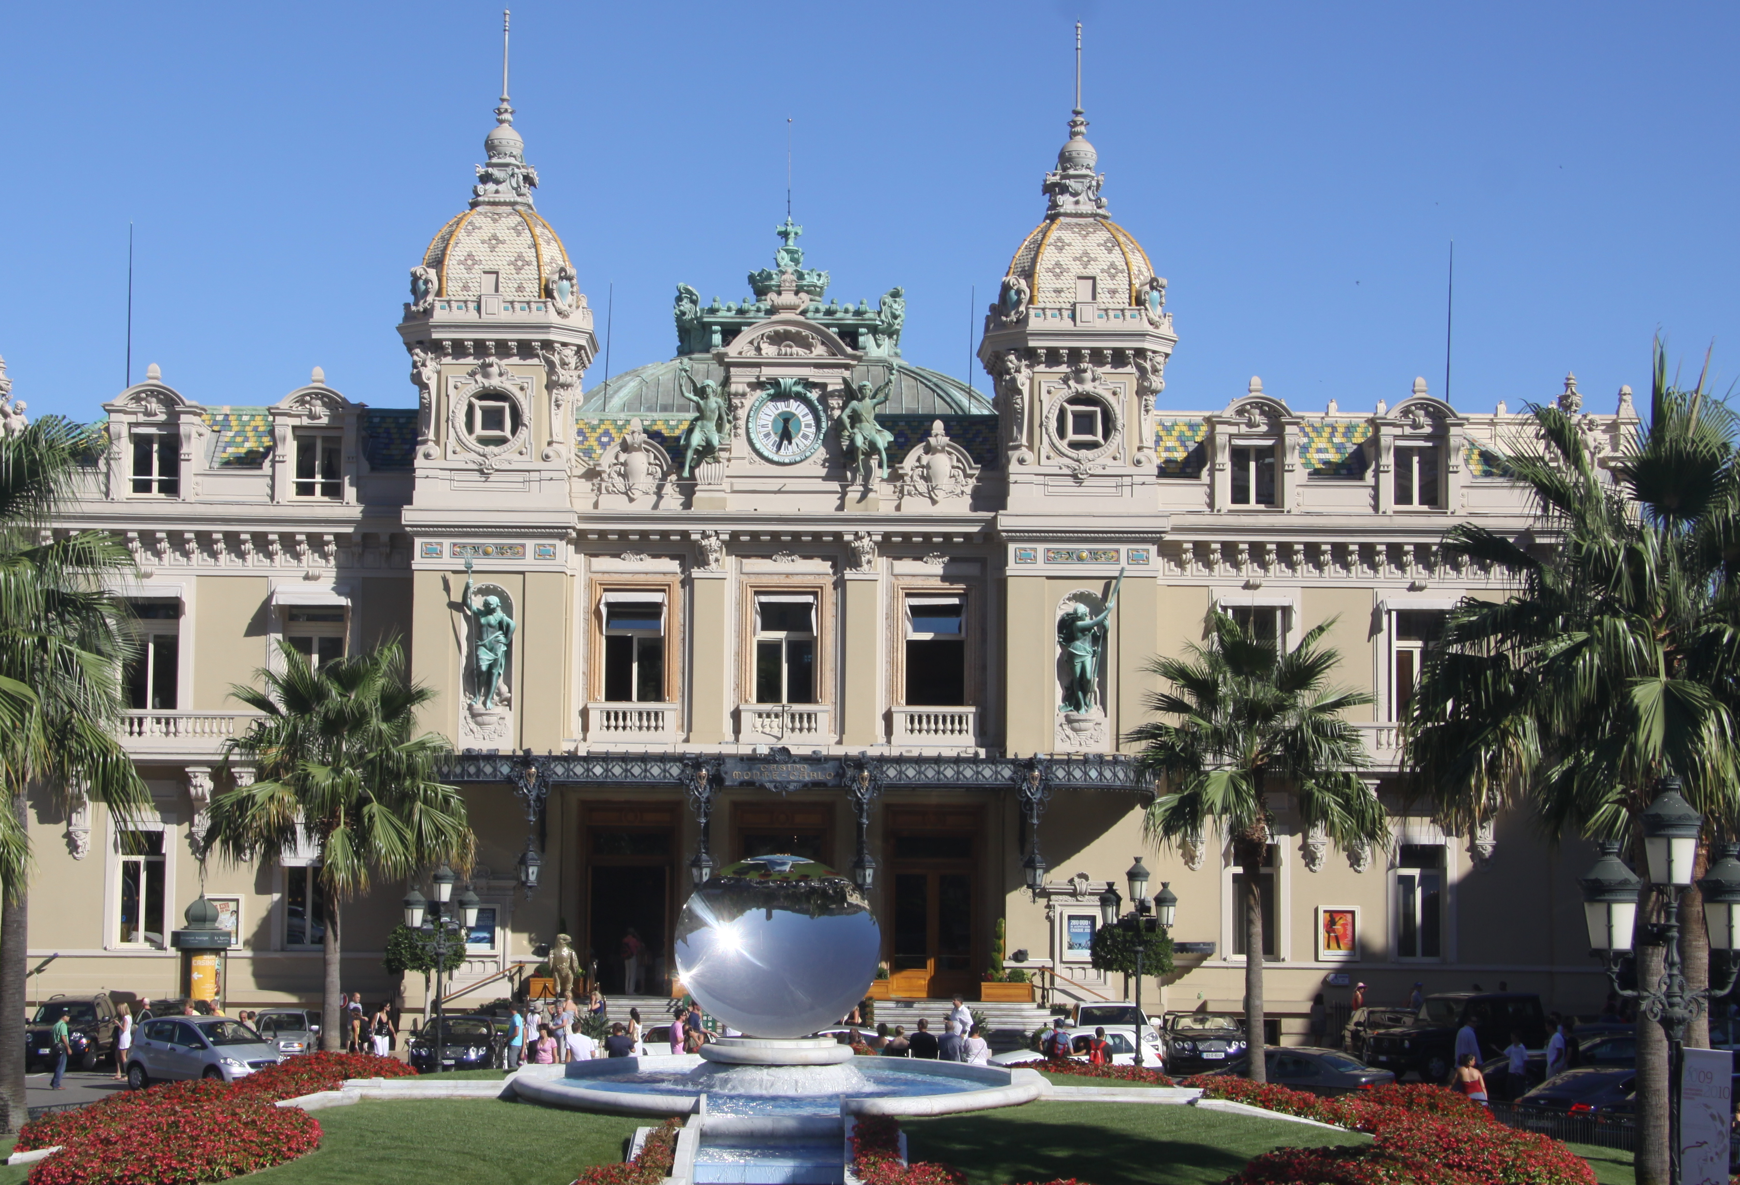
Algorithms – Monte Carlo Method
What?
Random sampling to obtain numerical results
Why?
Radiation transport, statistical physics
AI, CGI
How?
Simplest example: estimation of π
Notes:
Late 40’s Ulam’s uncle would gamble

Slide 30
Algorithms – Monte Carlo Method
How?
Simplest example: estimation of π
Throw darts at board
Score darts that hit in circle
π~4*Nh/N
Notes:
Nh/n = pi r^2/4r^2
=> Pi = 4 nh/n

Slide 31
Algorithms – Monte Carlo Method
How?
Compute CDF from PDF
Compute inverse of CDF
Obtain random number
Compute
$$CDF\left(x\right)=\int_{0}^{x}{p\left(x^{′}\right)dx^{′}}$$
$${CDF}^{−1}\left(x\right)$$
$$ξ$$
$$X_{i}={CDF}^{−1}(ξ)$$

Slide 32
Algorithms – Monte Carlo Method
How?
Photon interaction probability
Random interaction probability
$$e^{−τ}$$
$$=−ln⁡(ξ)$$

Slide 33
Algorithms – Monte Carlo Method
Further reading:
http://www.pbr-book.org/3ed-2018/Monte_Carlo_Integration.html
http://www-star.st-and.ac.uk/~kw25/teaching/mcrt/mcrt.html
https://www.scratchapixel.com/lessons/mathematics-physics-for-computer-graphics/monte-carlo-methods-mathematical-foundations/quick-introduction-to-monte-carlo-methods

Slide 34
Algorithms – Finite difference Method
What?
Numerical method to solve PDE’s & ODE’s
Why?
Easily adaptable method
How?
Taylor series approximation of derivatives
Notes:
Rearrange Taylor series for f’

Slide 35
Algorithms – Finite difference Method
$$\frac{∂T}{∂t}=α∇^{2}T$$
Solve heat equation
Forward
2nd order central
$$\frac{df}{dx}=\frac{f_{i+1 }+f_{i}}{Δx}$$
$$\frac{d^{2}f}{dx^{2}}=\frac{f_{i−1 }−2f_{i}+f_{i+1}}{Δx^{2}}$$

Slide 36
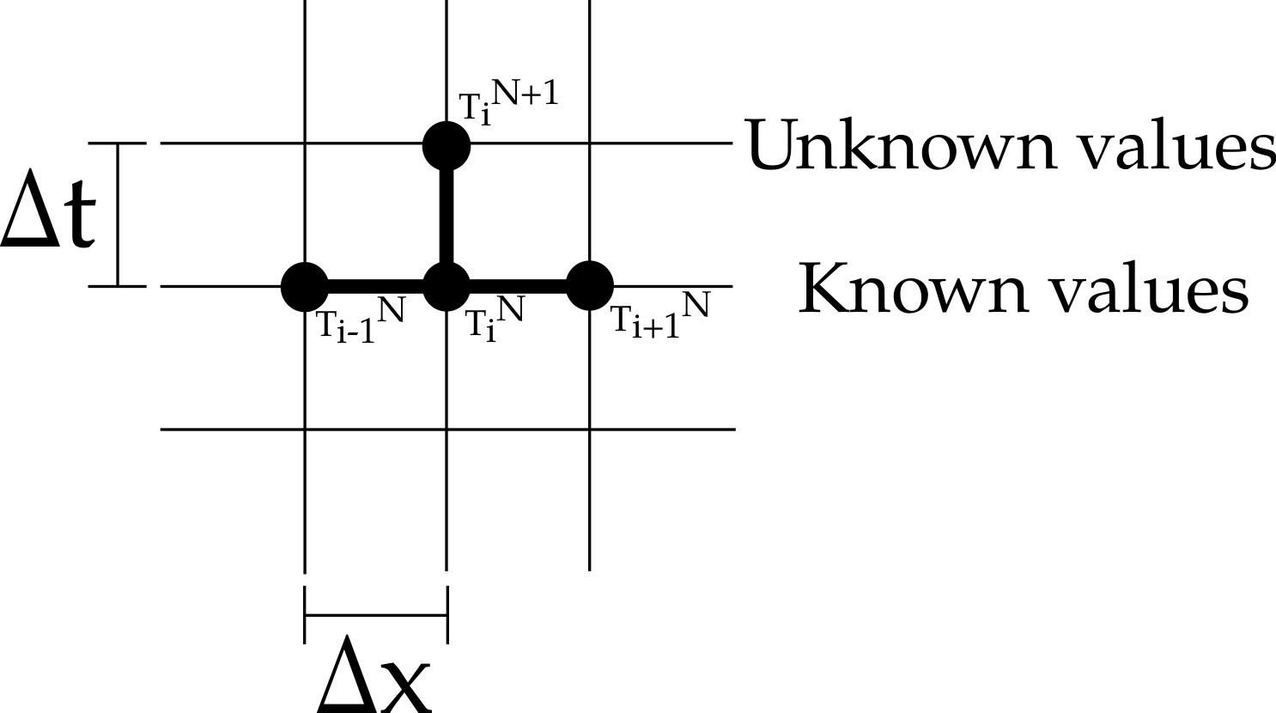
Algorithms – Finite difference Method
$$\frac{∂T}{∂t}=α∇^{2}T$$
Solve heat equation
$$T_{i}^{n+1}=T_{i}^{n}+αΔt\frac{T_{i−1}^{n}−{2T}_{i}^{n}+T_{i+1}^{n}}{Δx^{2}}$$

Slide 37
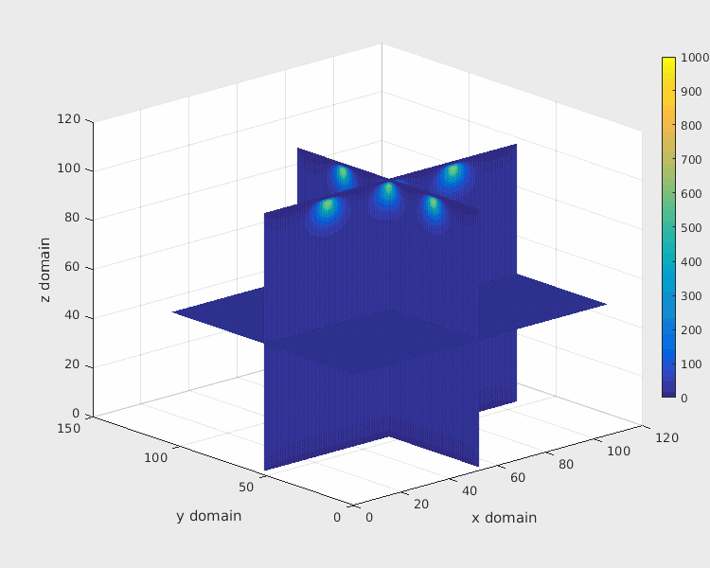

Slide 38
Algorithms – Finite difference Method
Further reading:
Finite difference schemes and partial differential equations / J. Strikwerda
Numerical Solution of Partial Differential Equations / D.Mayers and K. W. Morton
Finite difference methods in heat transfer / M. Özişik

Slide 39
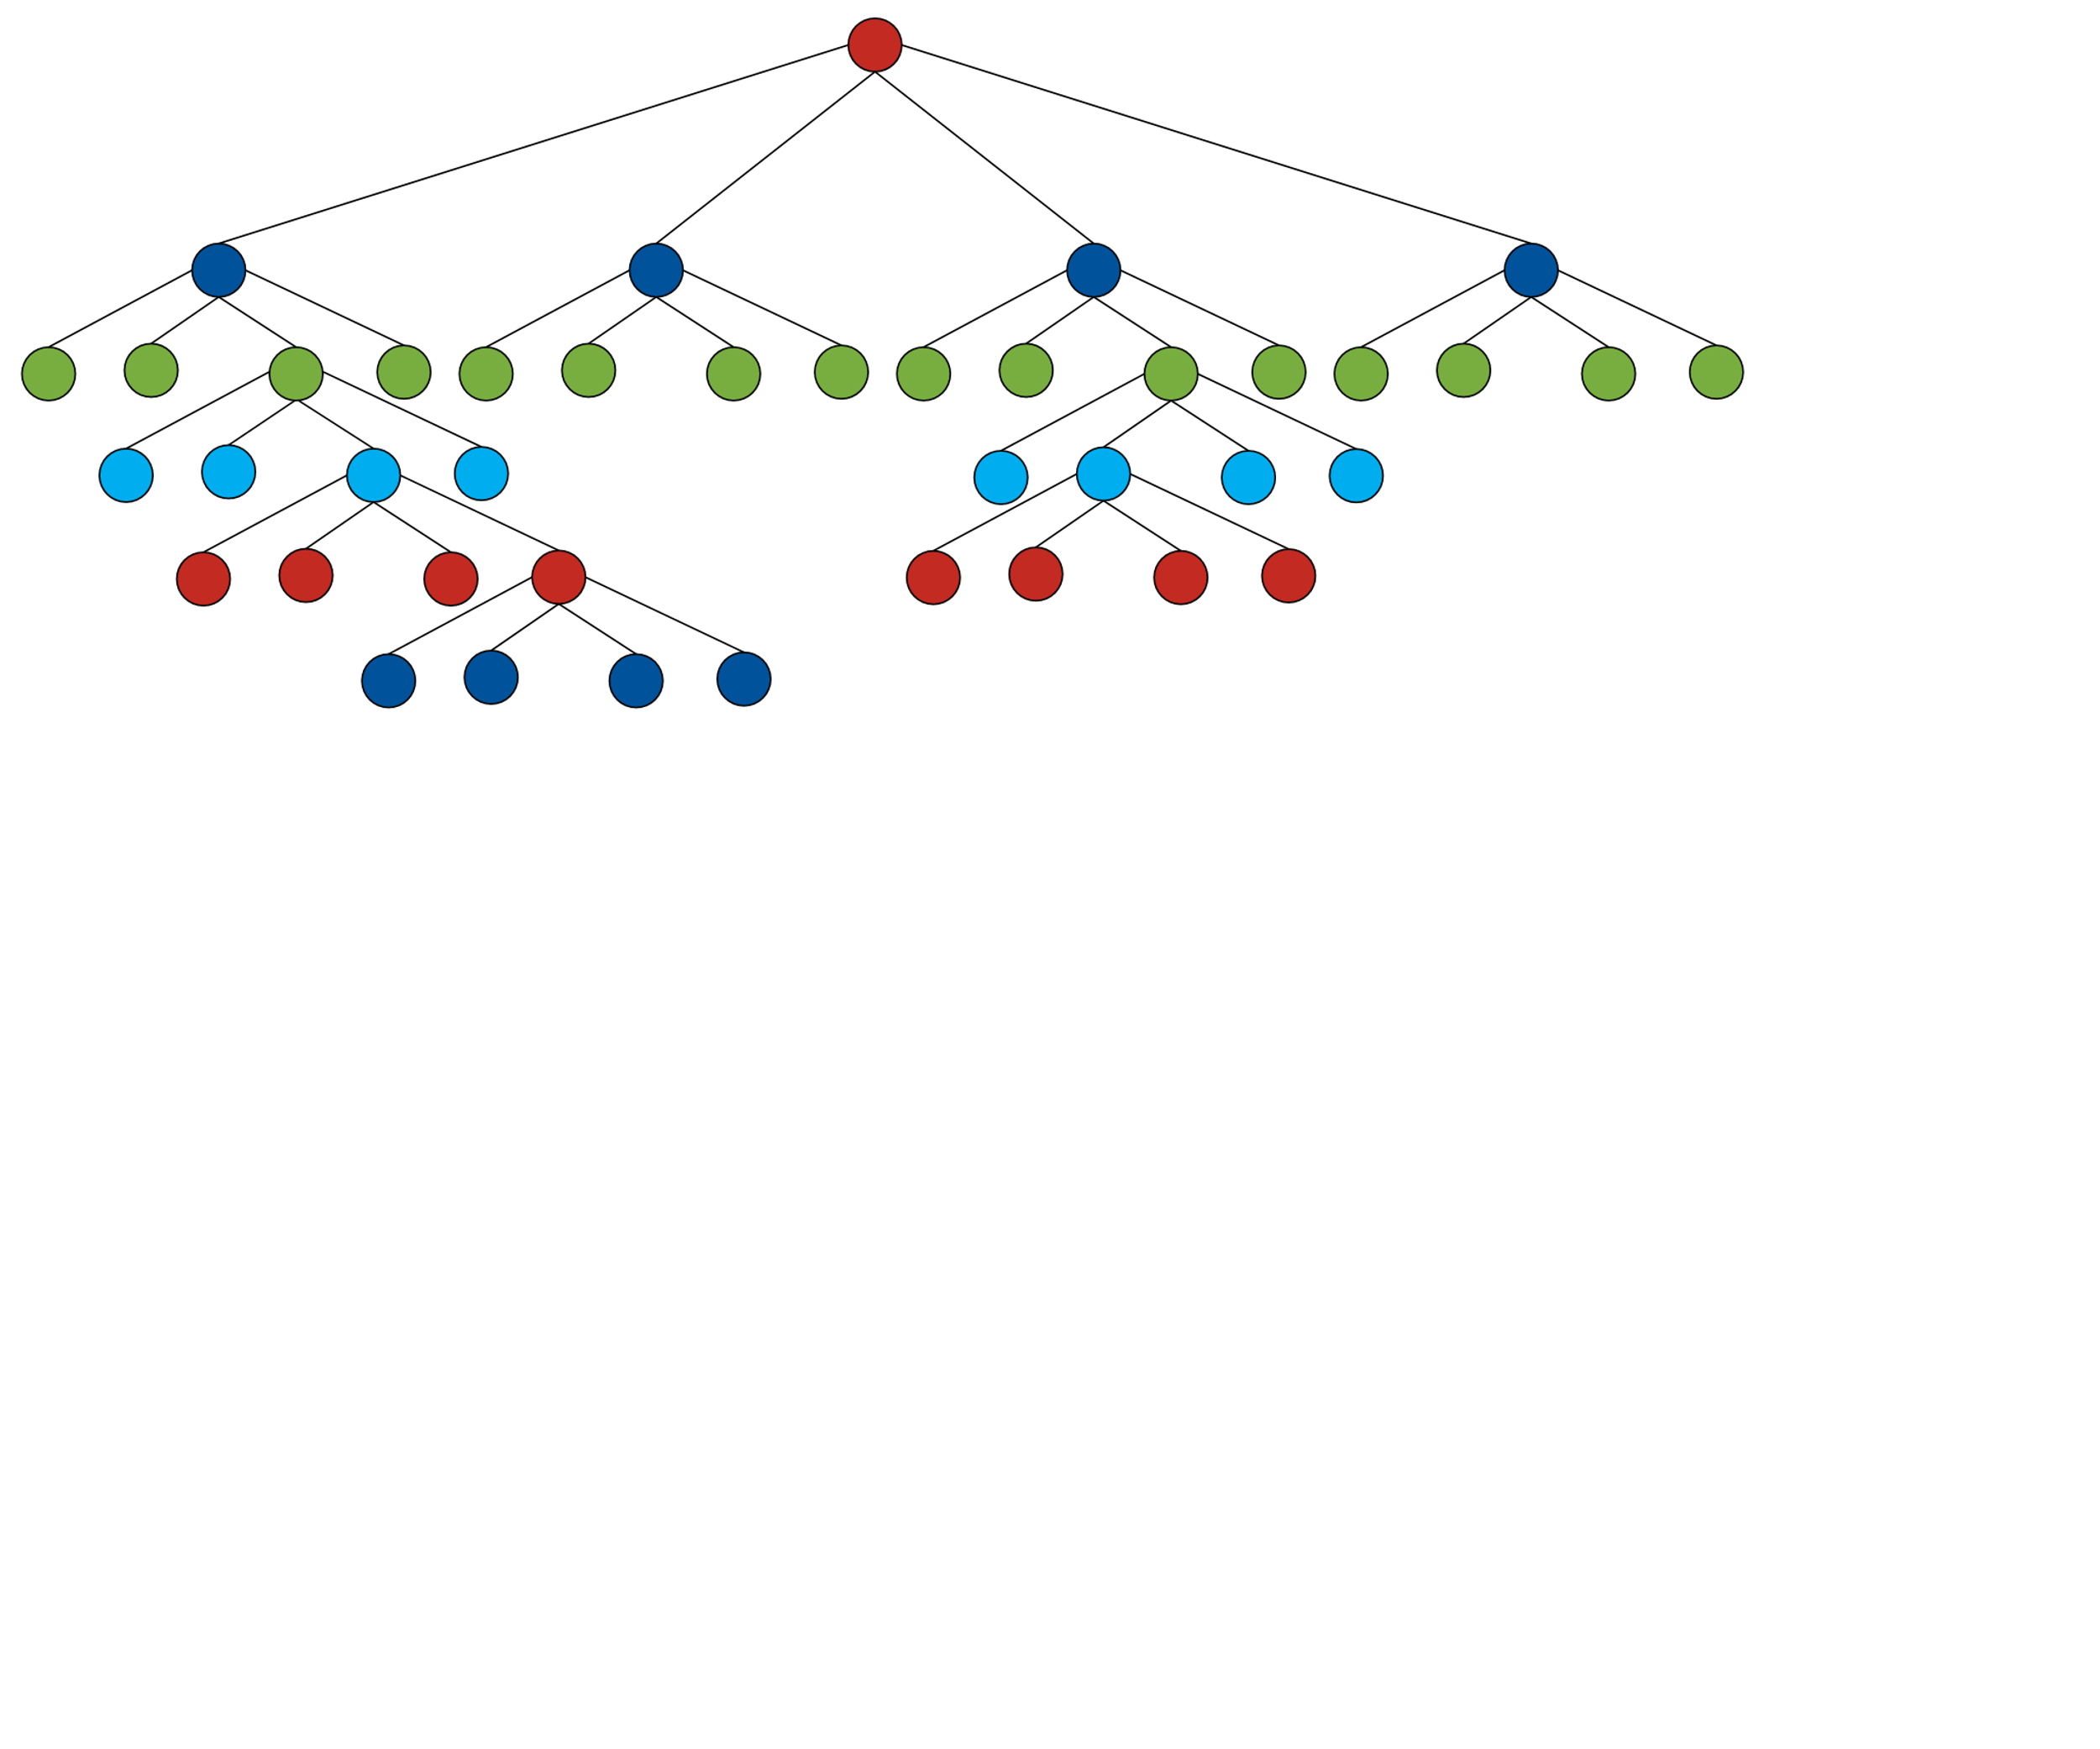
Algorithms - BVH
What?
Tree based data structures
Why?
Can drastically speed up computations
How?
Partitions space more efficiently

Slide 40
Algorithms - BVH

Slide 41
Algorithms - BVH
Works in 2D and 3D
Used in image compression
Used in n-body simulations
Used in fluid simulations
Plus many other fields

Slide 42
Algorithms - BVH
Further reading
“Physics” based
https://doi.org/10.1038/324446a0
http://arborjs.org/docs/barnes-hut
“Computer” based
http://www.pbr-book.org/3ed-2018/Primitives_and_Intersection_Acceleration/Further_Reading.html
https://www.scratchapixel.com/lessons/advanced-rendering/introduction-acceleration-structure

Slide 43
Questions
Slides available at: https://code-and-cake.github.io
https://www.youtube.com/watch?v=pgaEE27nsQw

